Slide 1
Experience on RTKs Quality Monitoring - Burundi
Dr. Hamidou Nzomwita, Deputy NACP-Burndi,
Dr. Franck Kavabushi, HIV/AIDS Clinical Services Specialist, DoD/PEPFAR,
Dr. Francine Karemera, PSI _Project Director _ Recency Surveillance
Cape Town, June 7th, 2024
RTCQI Workshop for Africa Region

Slide 2
Outline
Background
RTKs quality monitoring at the national level
RTKs quality monitoring at site level
Quality Control Process of RTKs at the site level
RTKs CQI at site level
National implementation of RTRI CQI
RTCQI Data Quality Management at national level
Lessons learned

Slide 3
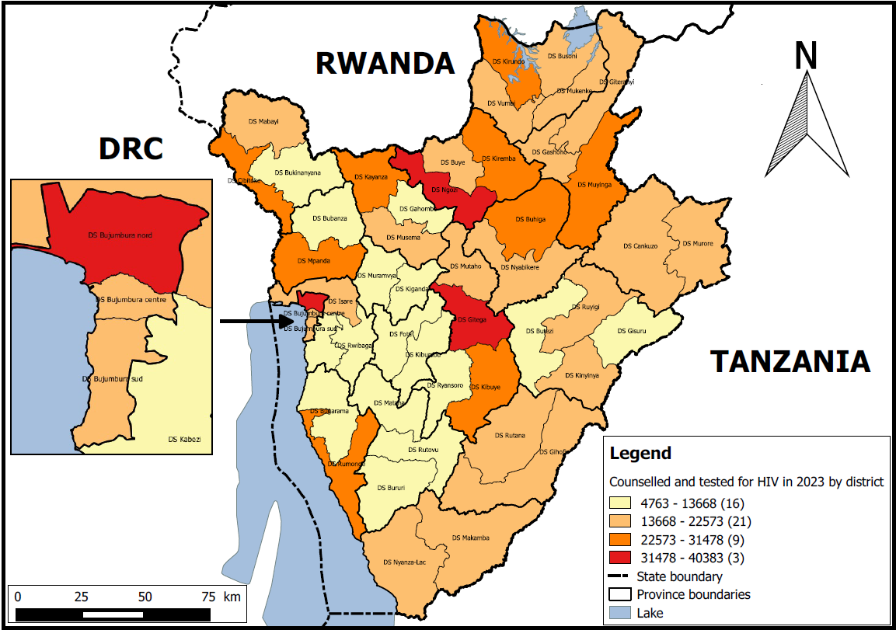
Background
HIV RT performed in all Health Facilities (HF),
QMS in place in all PEPFAR-supported HF,
Guidelines, SOPs, Job-Aids, Tools (registers, EMR, sheets, etc.) are available in all PEPFAR-supported HIV Testing services,
National Reference Lab – QA/QI.
Directives Nationales pour le Conseil et Dépistage du VIH (HIV Counseling and Testing National Guidelines ) include:
  A 3 tests HIV rapid testing algorithm,
  Quality Assurance including:
    HIV RT kit quality monitoring (reception, storage, before and during utilization of kits),
    Routine QA by the Site’s QA/QC Control Officer,
    959 sites/facilities offer HIV testing.
Note: Retesting prior ART initiation (will be soon included in the guidelines under review)
HIV RT used:
Determine HIV 1/2, kit SET (1st test),
SD BIOLINE HIV-1/2 3.0 (2nd test if 1st test Positive),
One Step HIV1/2 (3rd test if the 2nd is Positive).
SD BIOLINE HIV/Syphilis Duo (1st test for pregnant women).
Self test: OraQuick
RTRI test : Asanté ® HIV-1 RAPID RECENCY ® ASSAY
Source: DHIS2
Source: DHIS2

Slide 4
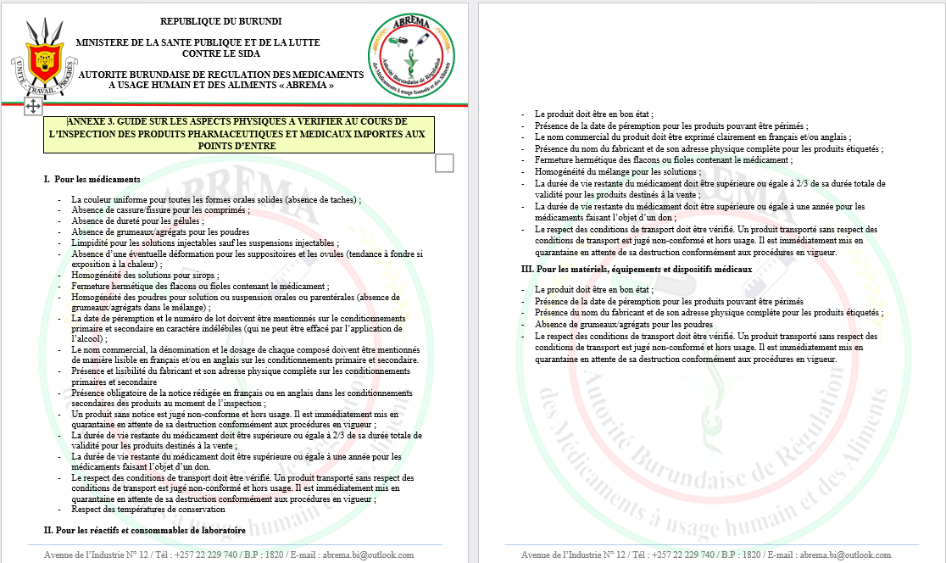
RTKs quality monitoring at national Level
Check list used for verification at HIV RT kits entry
Quality assurance of HIV RT kits followed during import process by the Burundi Regulatory Authority (ABREMA)
  Check the source of the RTKs during analysis of import requests (manufacturer and the country of origin)
  Check if the product is WHO prequalified, or SRA approved
  Check the presence of all required documents (from the importer, the supplier and/or the manufacturer)
Quality assurance upon delivery in country by the Regulatory Authority (ABREMA)
  Mandatory physical inspection at port of entry to verify the quality of the product imported
  Use of check list with key elements to be verified

Slide 5
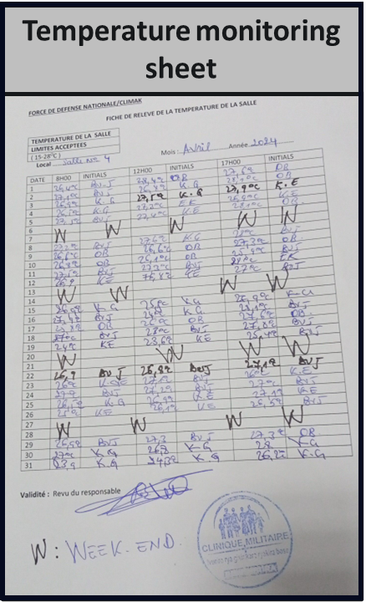
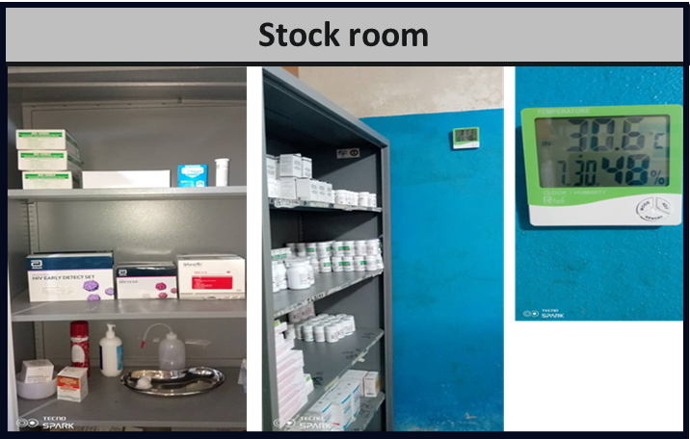
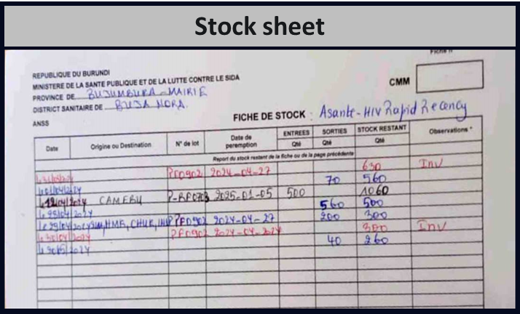
RTKs quality monitoring at the Site Level
Preparation and receipt of Kits
Upon receiving the kits, each lot is inspected to ensure they are not damaged and within the expiry dates.
Kits are stored immediately under the conditions recommended by the manufacturer (usually at room temperature or refrigerated, as specified).
Installation and enviromental conditions
Sites/laboratories use thermometers and hygrometers to monitor and record the daily temperature and humidity in the storage room.

Slide 6
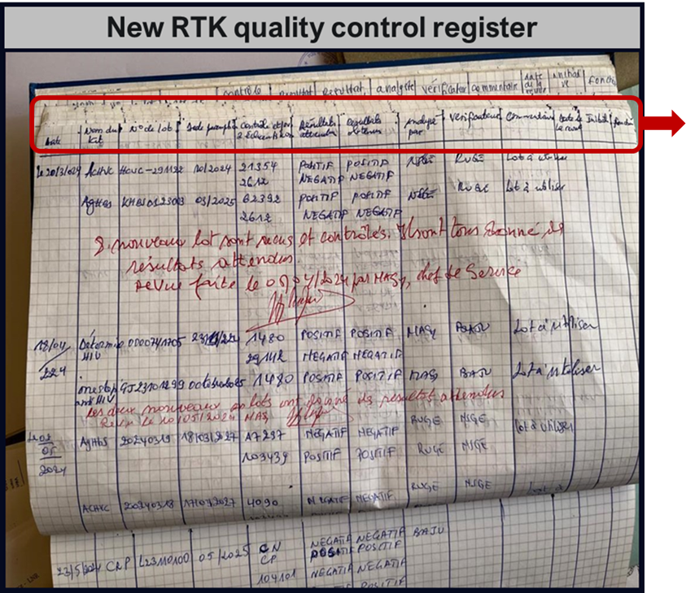
Quality Control Process of RTKs at the Site Level
Register contents:
Date,
Name of RTK,
Lot #,
Exp. date,
Control sample and/or sample number used for control,
Expected result,
Obtained result,
Tester’s name,
Checker’s name,
Comments,
Date of review.
Use of Positive and Negative Controls:
Positive and Negative Control samples provided by the manufacturer or certified sources are used to verify the performance of the test kits before use.
With each new batch of kits, the sites perform control tests for every new shipment, and periodically (e.g., daily or weekly).
Standardized Testing Procedures
Laboratories and sites use the manufacturer's protocols for performing tests.
Capacity Building and refresher trainings on Quality Assurance procedures and testing protocols are ensured regularly at the site level.
Guidance and SOPs are available at all testing sites.

Slide 7
RTKs CQI at Site Level
Data Analysis and Review
Trends of quality control results are analyzed monthly to check for anomalies indicating potential issues with the test kits or procedures.
Generate periodic performance reports to evaluate the effectiveness of the quality control procedures.
Documentation and Record Keeping
Maintenance of a detailed log of all tests performed including control and patient samples.
Ensure testing records are maintained in standardized logbooks or testing registers
All incidents, errors, or anomalies observed during testing are recorded.
Corrective and Preventive Actions
Conduct thorough investigations to determine the root causes of any test failures or unexpected results.
Apply corrective measures to address identified issues and prevent recurrence.
Participation in External Programs - External Quality Assessment (EQA):
Some laboratories participate in external quality assessment programs (AMREF) to benchmark the laboratory's performance against external standards and receive independent validation of test accuracy.
However, few sites currently participate in PT

Slide 8
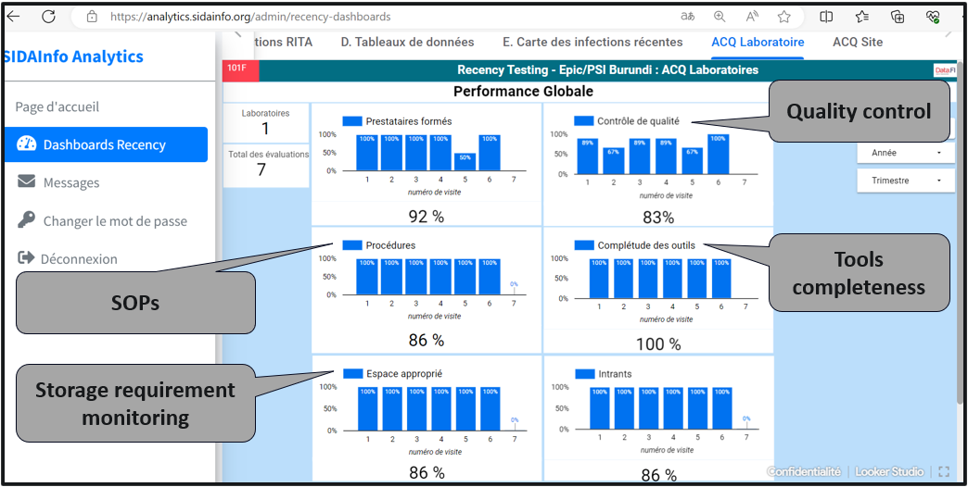
National implementation of RTRI CQI
Recency CQI dashboard just developed.
Next steps:
  Quarter supervisions by MoH to be recorded so that dashboards can be generated
  Start monthly data analysis for routine monitoring and corrective actions
  Data driven approach to ensure the quality of HIV recency testing in supported sites
Data source: SIDAInfo Recency Dashboard – National EMR

Slide 9
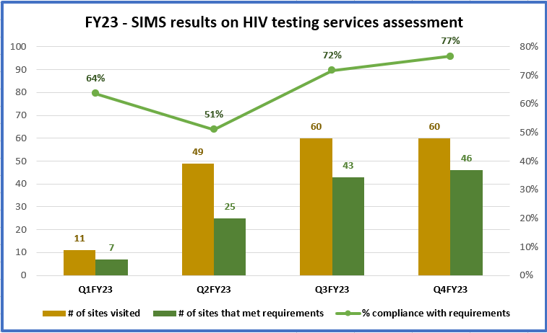
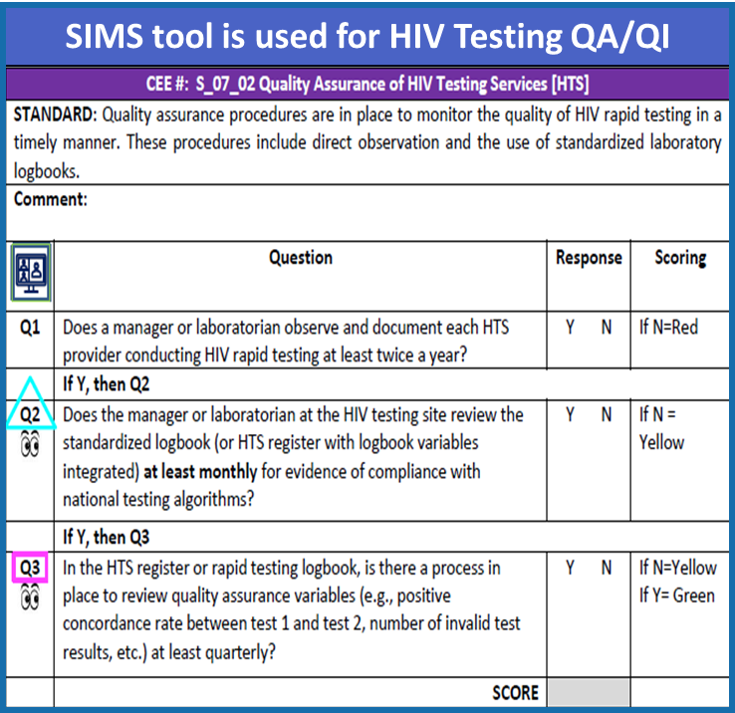
RTCQI Data Quality Management at National Level
Source: SIMS 4.2 tool
PEPFAR team and its IPs in collaboration with NACP and Health District Teams leverage the SIMS tool for QA and CQI:
Joint site visits and follow up visit depending on findings – Implementation of remediation plans
QM assessment data are reviewed by PEPFAR Team during the PEPFAR IPs’ Quarterly Performance Review Meetings.
During those meetings, the National AIDS Control Program is invited as well as other partners such as GF, WHO.
Data source: FY23 SIMS results third party partner reporting
Challenges:
RTK QM at National level is ensured by the National Reference Lab, => Lack of resources 🡪 Only VL tests and TB diagnosis are prioritized.

Slide 10
Lessons learned
HIV RTKs storage requirement monitoring is the key to preserving HIV RTKs’ quality
Continuous capacity building of testers ensure provision of accurate testing results
Training of non-medical HIV testing counselors ensured increased access to HIV testing services while maintaining quality of services.

Slide 11
Thank you,
Murakoze

